Slide 1

MEDICAL ANALYSIS FOR PAITENTS WITH DIABETES IN RELATION TO ULCER, SMOKERS AND AGE GROUP
PRESENTED BY MODUPE MISTURA JUNAID

Slide 2
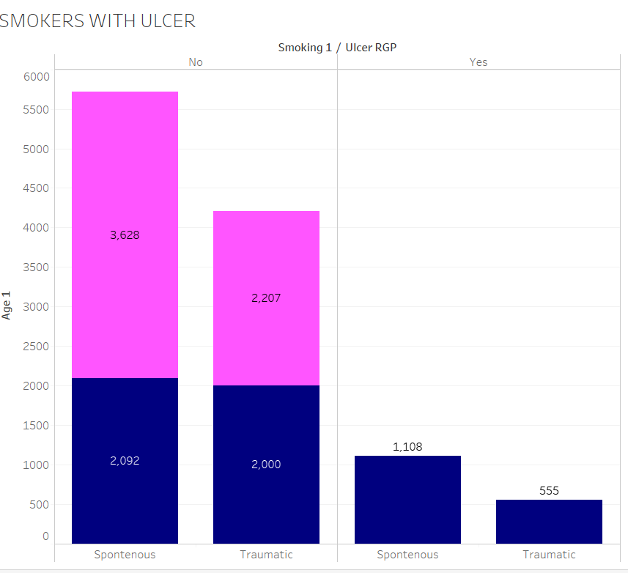

RELATIONSHIP BETWEEN SMOKERS AND ULCER
Notes:
There is no strong Relationship between smokers with ulcer

Slide 3
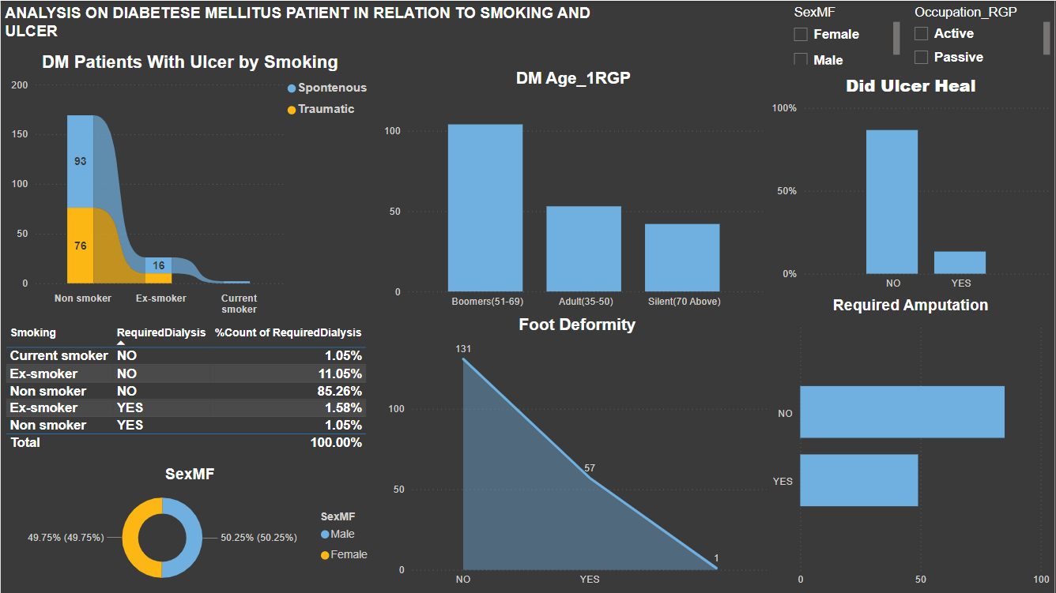

Slide 4
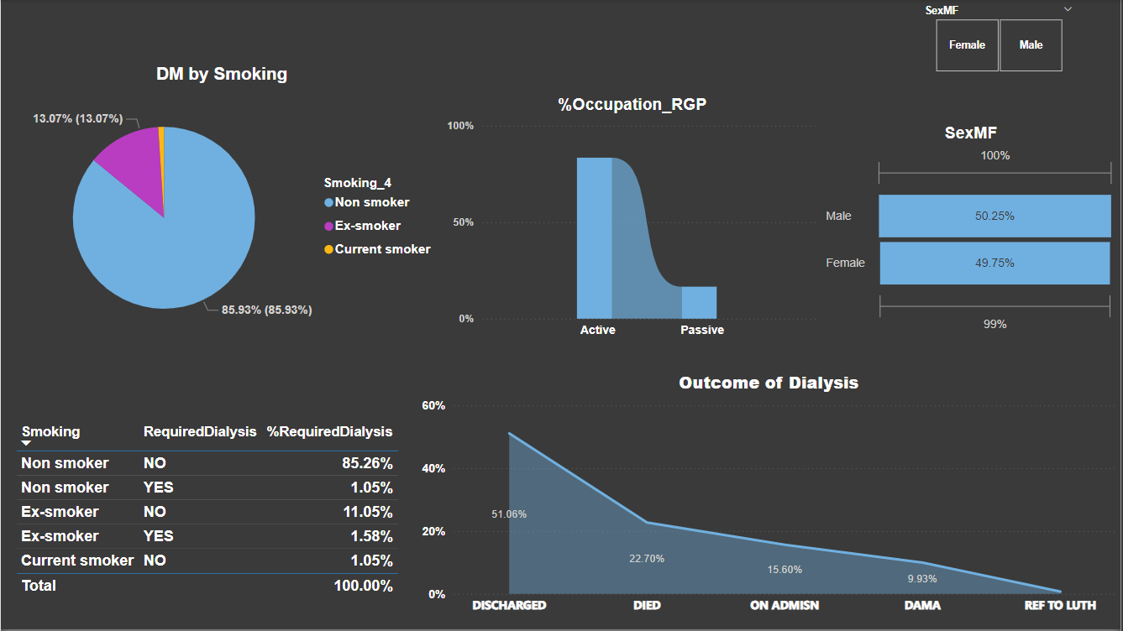
According to this analytics, smocking do not have any relationship with ulcer Although it is seen that non smoker healed from their ulcer than current or Ex smokers

Slide 5



Slide 6
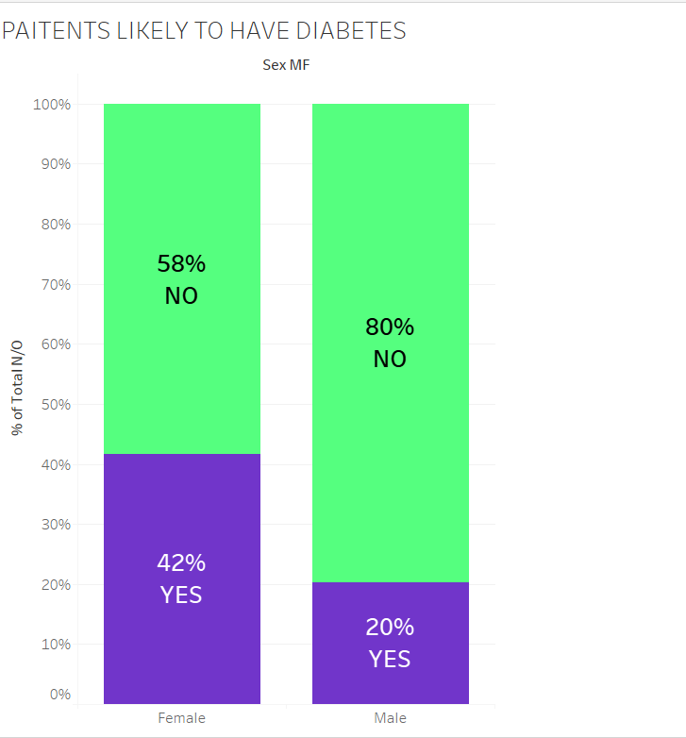

AN AB TEST OF GENDER LIKELY TO HAVE DIABETES
Notes:
Female Gender is most likely to have diabetes than males

Slide 7
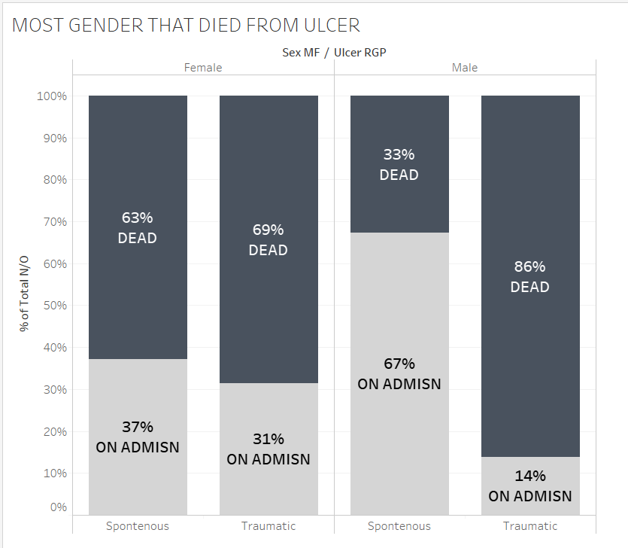

AD TEST OF GENDERS LIKELY TO DIE FROM ULCER RATHER THAN DIABETES
Notes:
Male gender died more from traumatic ulcer than female

Slide 8
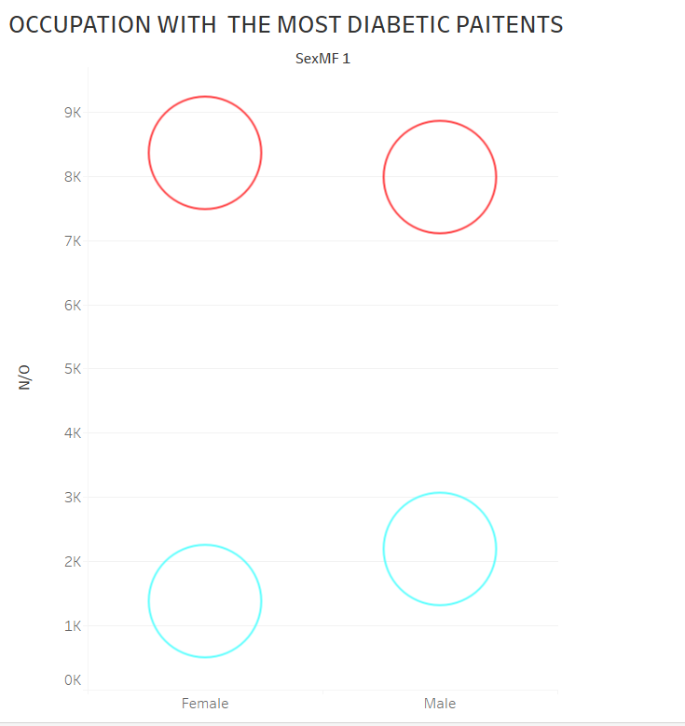


OCCUPATION WITH THE MOST DIABETES PAITENTS
Notes:
Active category of occupation is more likely to have Diabetes

Slide 9



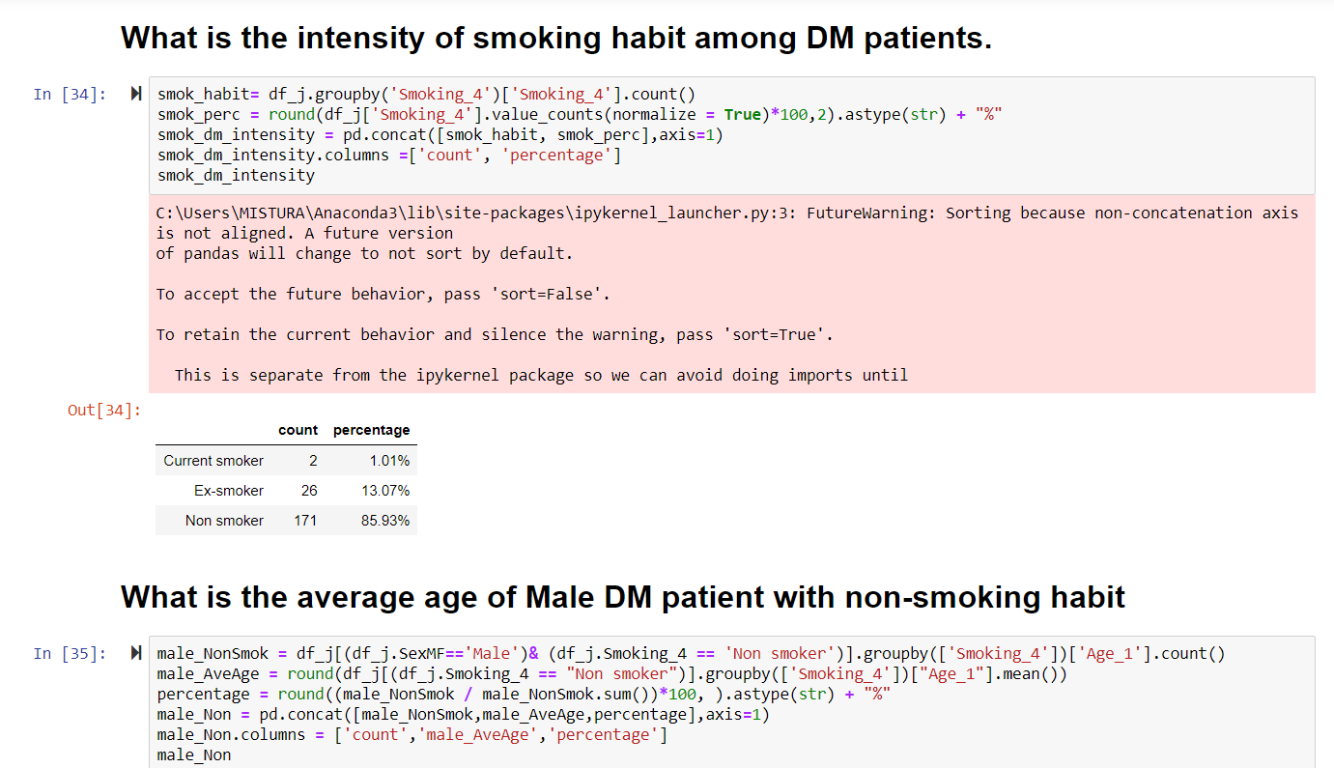
SUMMARY
Notes:
CONCLUSIO

Slide 10



Slide 11
Conclusion
Diabetes does not discriminate against Gender. The age group of males that got their feet amputated is almost equal to that if female
This data proves a few thing:
Although there is no direct like that proves that that smoking is the cause of ulcer but when it comes to healing, non smokers have a higher tendency of healing rom ulcer than smokers
The highest Age Group with diabetes is the Boomers(51-69 years)
13% of patients still died even after amputation
Only a small percent of diabetic patient got heart failure and it happened within the ade 35-50(Adult) and 51-69(boomers)
More women are likely to die from diabetes than men.

